Slide 1
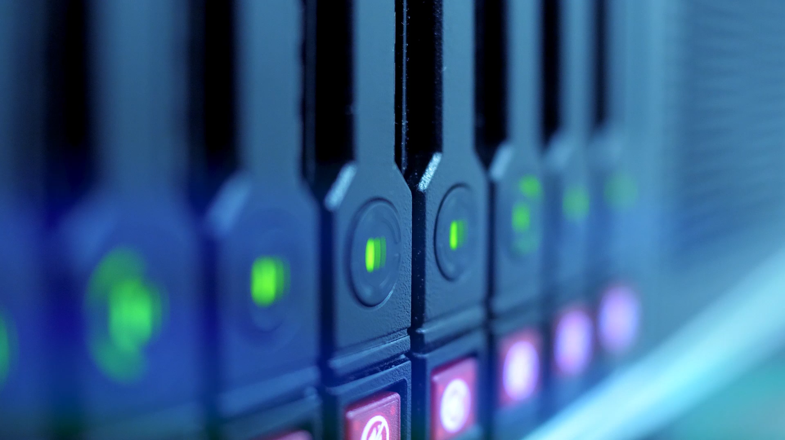
VENDING MACHINE

Slide 2
CONTENTS
* PROJECT INTRODUCTION
* STATE DIAGRAM
* VERILOG CODE
* RESULT

Slide 3
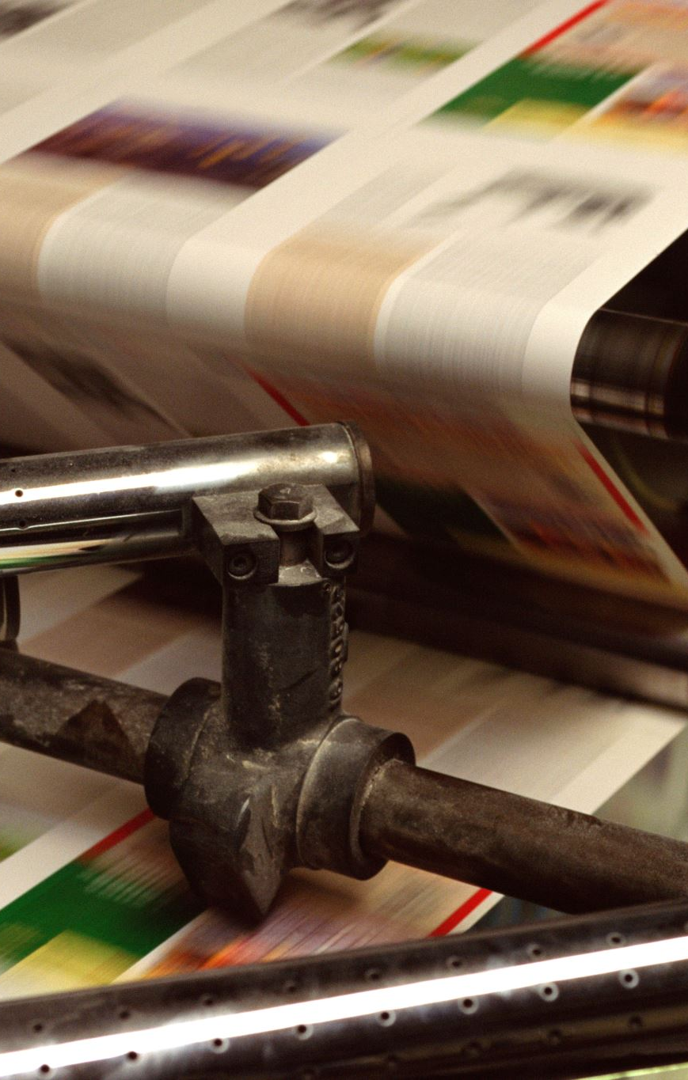
ABSTRACT
Machine as we all know is a machine which can vend different products which is more like an automated process with no requirement of man handling which we normally see in fast moving cities because of fast paced life. This paper compares different aspects like area, timing constraint, speed, power dissipation of a vending machine with 2 different design styles algorithm while installation. FSM based algorithm has been utilized to simulate model

Slide 4
* PROJECT INTRODUCTION
An automated machine which is intended to provide the users with a diverse range of products: snacks, beverages, pizzas, cupcakes, newspapers, tickets, etc. A vending machine dispenses a product to the users based on the amount of money inserted and selection of the product. Vending machine is a 24x7 standalone unit which requires a standard power supply connection to function. It consist of simple electro-mechanical systems which helps to automate the entire vending process.

Slide 5
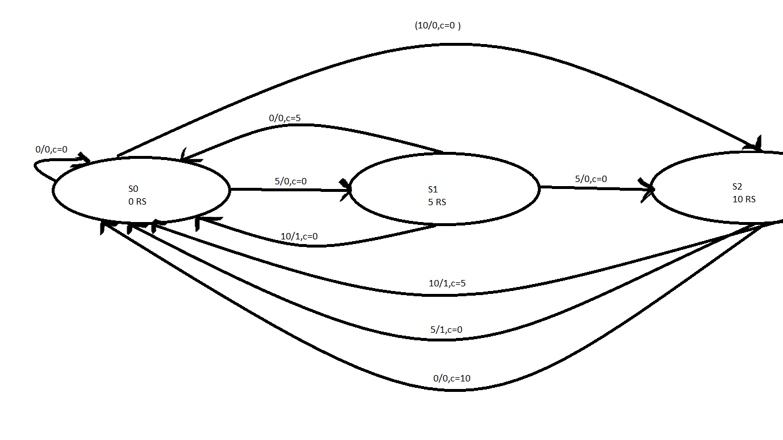
* STATE DIAGRAM

Slide 6
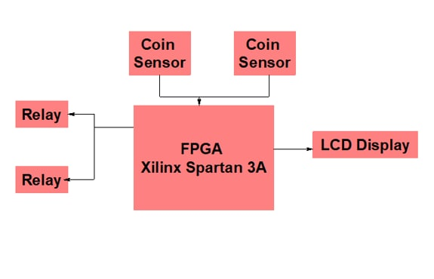
BLOCK DIAGRAM

Slide 7
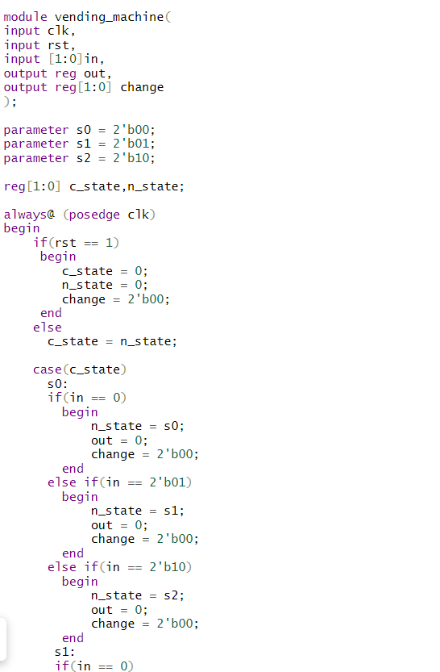

* VERILOG CODE

Slide 8
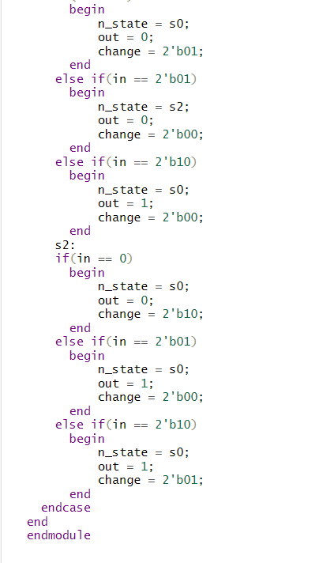

Slide 9
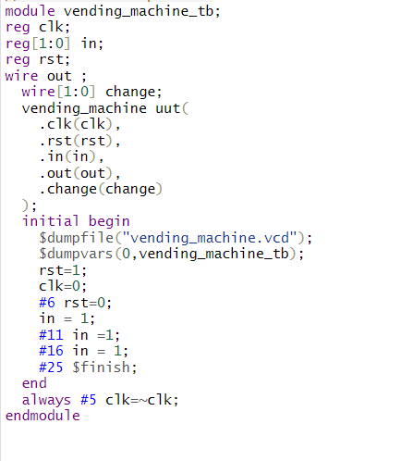
TEST BENCH CODE

Slide 10
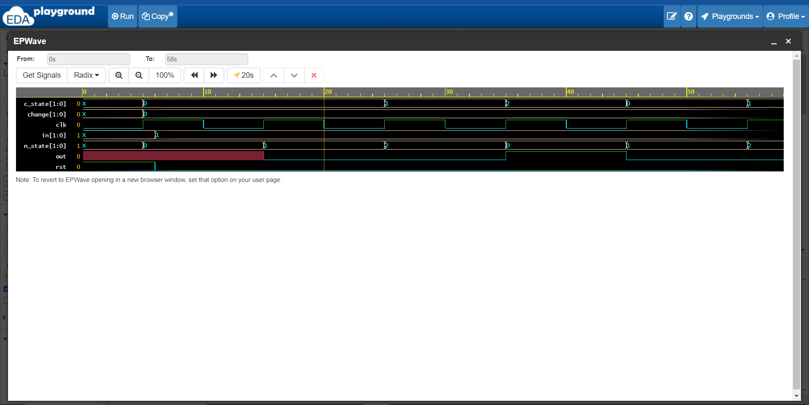
* RESULt

Slide 11
Intended functions
(1) Vending machine must be self-explanatory and accessible to a vast array of users without prior training
(2) Vending machine must offer efficient service with no tolerance for human error
(3) It should successfully dispense the desired selection of snack at any point of time
(4) Vending machine should maintain the quality of the snack from the point when itâ€™s stored until its dispensation

Slide 12
IMPROVEMENTS
(1) Sophisticated automated system : A two-axis robot which would help to pick and place the selected snack in the dispense chute. The robotic arm will eliminate the possibility of snack getting stuck in the machine and snack inducing damage due to the free fall in the dispense chute.
(2) Interactive displays : Instead of having traditional glass displays, large digital LED touchscreen displays would help to attract user attention. This large display will help to keep users engaged by presenting users with additional product information (like ingredients and calorie content), news feeds, gaming, and social networking updates.
(3) Integrated sensors : Sensors would enable use of various payment technologies like credit/debit cards, mobile payments, QR code billing etc. These payment options will not constraint the users from using the vending machine if they do not have cash on hand. Additional sensors would also help to track user behavior and recommend rotation of snacks based on demographics.

Slide 13


